Slide 1
Distributed training in DGL
Da Zheng

Slide 2
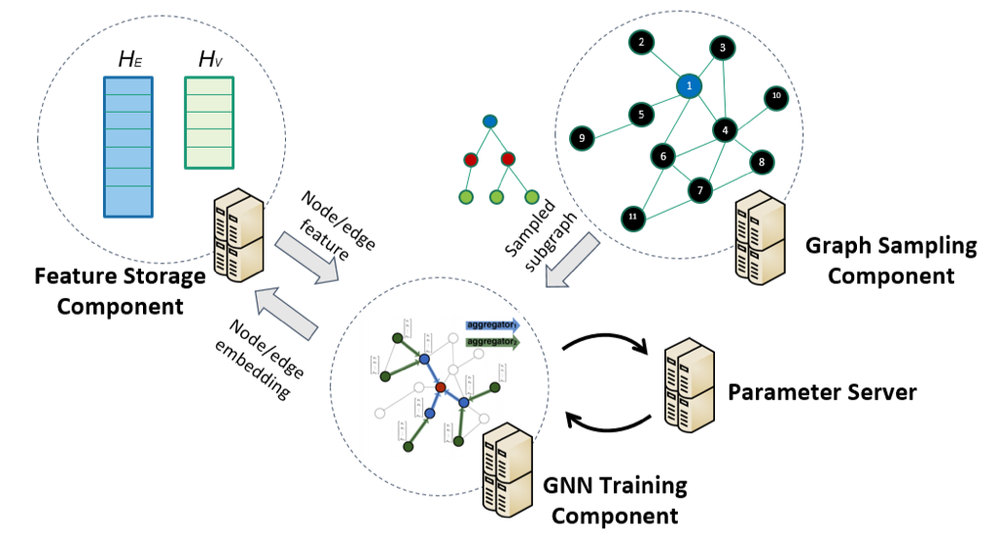
Overview
Fully distributed
Locality-aware partition
Strike for linear speedup
Minimize code change

Slide 3
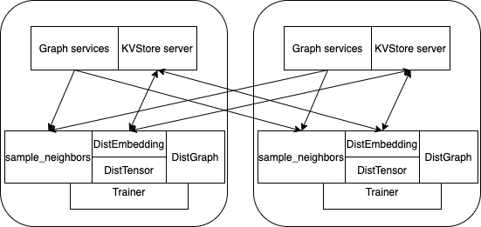
Distributed architecture
All machines run servers and trainers.
DGL partitions a graph and one machine is responsible for one partition.
Trainer processes access distributed data via:
DistGraph for both graph structure and node/edge data.
DistTensor and DistEmbedding accesses distributed tensors.
sample_neighbors samples subgraphs.

Slide 4
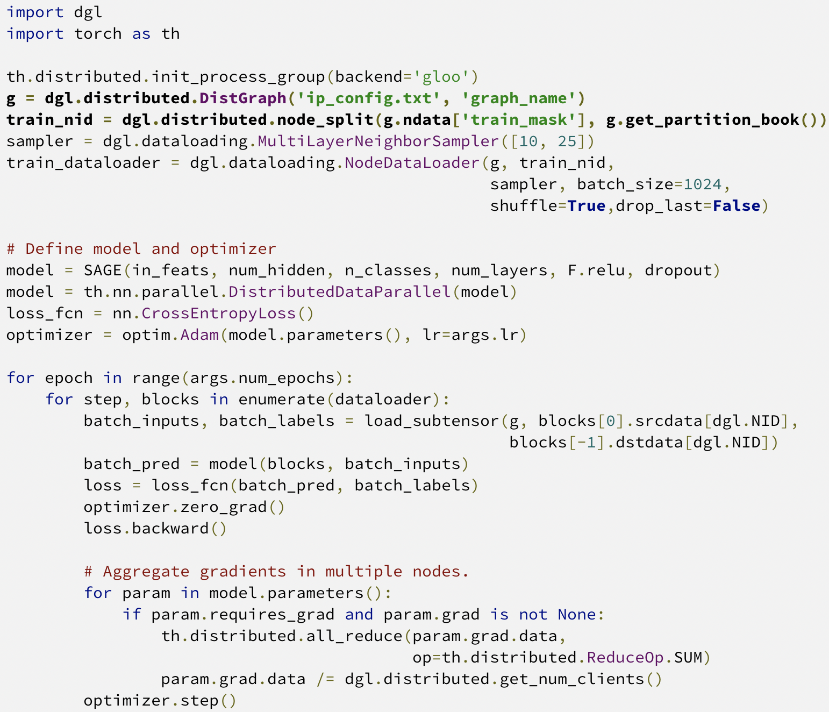
Overview of distributed training code
Little modification is required for distributed training.
Use DistGraph for the distributed graph.
Use node_split to get the local training set for the trainer process.

Slide 5
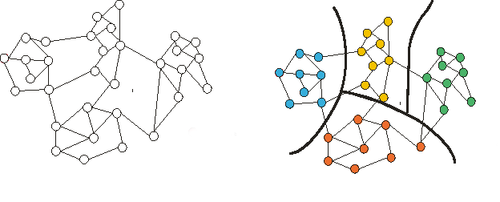
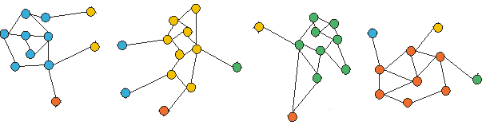
Graph partitioning
Metis graph partitioning assigns nodes to partitions.
Minimize edge cuts
Split the graph into subgraphs with Halo nodes.
One partition per machine.
The graph structure for a partition.
Features for nodes/edges that belong to the partition (no duplication).
metis
Split graph with Halo nodes
Part 0
Machine 0
Part 1
Machine 1
Part 2
Machine 2
Part 3
Machine 3

Slide 6
Load balancing with Metis
Balancing criteria:
The number of nodes for each node type
In-degrees of nodes for each node type
Balance the sizes of training, validation and testing
Treat nodes in training, validation and testing sets as different node types.

Slide 7
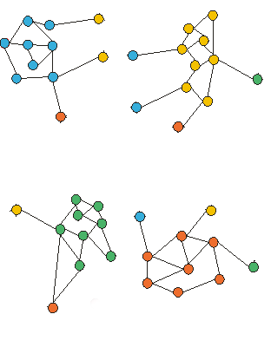
Id relabeling
0
1
8
10
9
2
3
4
8
11
14
1
13
Why relabeling?
Mapping a node/edge to a partition requires large memory (#nodes/#edges in a graph).
Relabel node Ids and edge Ids:
All node/edge Ids in a partition fall in a contiguous range.
Only a small array (#partitions) is required to map node/edge to a partition.
The distributed code doesn’t care about Id relabeling.
Node/Edge features are reshuffled accordingly.
6
7
12
16
5
14
7
15
26
24
Part 0
Machine 0
Part 1
Machine 1
13
17
18
7
15
16
19
20
24
25
21
23
26
27
22
22
28
29
25
30
Part 2
Machine 2
Part 3
Machine 3

Slide 8
Tools for graph partitioning
DGL provides graph partitioning in two forms:
API: dgl.distributed.partition_graph
Load a graph to DGL in a customized way.
More controls for load balancing.
Python script: tools/partition.py
Input graph: a file that stores a graph in the DGL format.
Pre-defined load balancing.

Slide 9
Partition results
A JSON file to store the partition configurations.
Node/edge mapping file (optional)
If node/edge Id relabeling is enabled, there is no node/edge mapping files.
Data for each partition (in the DGL format)
Graph structure of a partition.
Features of nodes that belong to the partition.
Features of edges that belong to the partition.
data_root_dir/
|-- graph_name.json
|-- node_map.npy
|-- edge_map.npy
|-- part0/
|-- node_feats.dgl
|-- edge_feats.dgl
|-- graph.dgl
|-- part1/
|-- node_feats.dgl
|-- edge_feats.dgl
|-- graph.dgl
….

Slide 10
DistGraph
A Python class in the trainer process for accessing the graph structure and node/edge features in the cluster of machines.
Execution mode: distributed vs. standalone
Standalone: model development and testing.
Distributed: run code in a cluster.
No code change when switching between standalone and distributed.
Node/edge Ids used in DistGraph are global Ids.
DistGraph provides a small subset of APIs in DGLGraph.
Part 0
Machine 0
Part 1
Machine 1
Part 2
Machine 2
Part 3
Machine 3
DistGraph
DistGraph
DistGraph
DistGraph
Trainer
Trainer
Trainer
Trainer

Slide 11
DistGraph creation
Distributed mode:
Graph data is loaded by DGL servers.
DistGraph connects to the DGL servers.
Standalone mode:
data is loaded by DistGraph.
>>> import dgl
>>> g = dgl.distributed.DistGraph(‘ip_config.txt’, ‘graph_name’)
>>> import dgl
>>> g = dgl.distributed.DistGraph(‘ip_config.txt’, ‘graph_name’, conf_file=’data/graph_name.json’)

Slide 12
Data access in DistGraph
Access graph structure:
The access to the graph structure is very limited.
Access node/edge data:
ndata
edata
>>> print(g.number_of_nodes())
>>> g.ndata[‘train_mask’]
<dgl.distributed.dist_graph.DistTensor at 0x7fec820937b8>
>>> g.ndata[‘train_mask’][0]
tensor([1], dtype=torch.uint8)

Slide 13
Distributed tensor
dgl.distributed.DistTensor accesses tensors sharded in a cluster of machines.
Data is accessed with global row Ids.
Distributed tensor creation and deletion are synchronized operations.
Part 0
Machine 0
Part 1
Machine 1
Part 2
Machine 2
Part 3
Machine 3
read
write
DistGraph
DistGraph
DistGraph
DistGraph
Trainer
Trainer
Trainer
Trainer

Slide 14
Operations on DistTensor
Create DistTensor
Allocate memory if the tensor identified by the tensor name doesn’t exist in the cluster.
Reuse the tensor if the tensor identified by the tensor name exists.
This is a synchronized operation.
Read DistTensor: copy specified rows to the local process.
Write DistTensor: write data to the specified rows.
>>> tensor = dgl.distributed.DistTensor(g, (g.number_of_nodes(), 10), th.float32, ‘test’)
>>> data = tensor[0:100]
>>> tensor[0:100] = data

Slide 15
Distributed Embedding
dgl.distributed.DistEmbedding accesses embeddings sharded in a cluster of machines.
Data is accessed with global row Ids.
Update embeddings with DGL’s sparse optimizer.
Distributed embedding creation and deletion are synchronized operations.
Part 0
Machine 0
Part 1
Machine 1
Part 2
Machine 2
Part 3
Machine 3
read
Update with
gradients
DistGraph
DistGraph
DistGraph
DistGraph
Trainer
Trainer
Trainer
Trainer

Slide 16
Operations on Distributed Embeddings
Create DistEmbedding
Allocate memory if the embeddings identified by the name doesn’t exist in the cluster.
Reuse the embeddings if the embeddings identified by the tensor name exists.
This is a synchronized operation.
Read DistEmbedding: copy specified rows to the local process.
>>> emb = dgl.distributed.DistEmbedding(g, g.number_of_nodes(), 10, ‘test’)
>>> data = emb(np.arrange(100))

Slide 17
Operations on Distributed Embeddings
Update embeddings with DGL’s sparse optimizer.
Currently, DGL provides dgl.distributed.SparseAdagrad.
When step is invoked, the embeddings of row 0, 1, 2, 3 are updated by SparseAdagrad.
>>> optimizer = dgl.distributed.SparseAdagrad([emb], lr=0.001)
>>> feats = emb([0,1,2,3])
>>> loss = th.sum(feats + 1)
>>> loss.backward()
>>> optimizer.step()

Slide 18
Graph sampling
DGL provides distributed sampling: dgl.distributed.sample_neighbors
The high-level sampling APIs (e.g., NodeDataLoader, EdgeDataLoader) work for both DGLGraph and DistGraph.
>>> sampler = dgl.dataloading.MultiLayerNeighborSampler([10, 25])
>>> train_dataloader = dgl.dataloading.NodeDataLoader(
g, train_nid, sampler,
batch_size=1024,
shuffle=True,
drop_last=False
)

Slide 19
Split training, validation and test set
Store the training/validation/test set in mask tensors in preprocessing.
Get nodes/edges from the training set in a trainer process.
>>> g.ndata['train_mask']
>>> train_nid = dgl.distributed.node_split(g.ndata['train_mask'])

Slide 20
Launch distributed training
DGL provides a launch script to run distributed training and inference in a cluster of machines.
The script launches the servers and trainers on the same cluster of machines.
--num_trainers specifies the number of trainers per machine.
python3 ~/dgl/tools/launch.py \
--workspace ~/graphsage/ \
--num_trainers 2 \
--conf_path data/ogb-product.json \
--ip_config ip_config.txt \
"python3 train_dist.py --graph-name ogb-product --ip_config ip_config.txt --num-epochs 30 --batch-size 1000 --lr 0.1"

Slide 21
The IP configurations of the cluster
The launch script requires an IP configuration file to specify a cluster of machines.
The format of the IP configuration file:
(IP, port, # server processes per machine)
172.31.16.250 5555 1
172.31.30.135 5555 1
172.31.27.41 5555 1
172.31.30.149 5555 1

